Slide 1

Nucleic Acids
Alberto Perez
https://perez.chem.ufl.edu

Slide 2
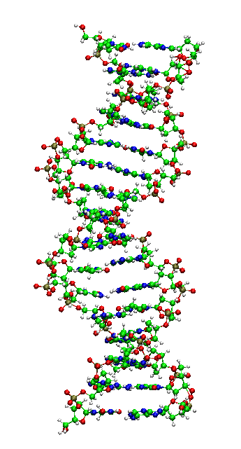
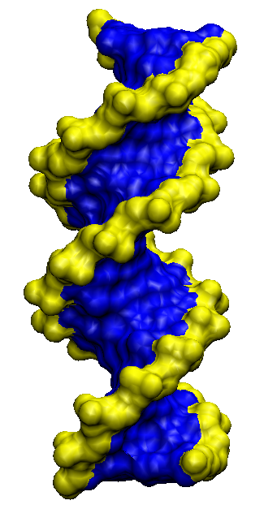
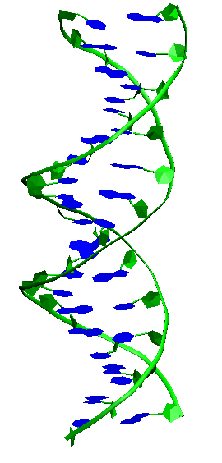
Classical view
DNA —> genes —> RNA(m) —> Proteins

Slide 3
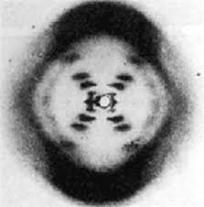
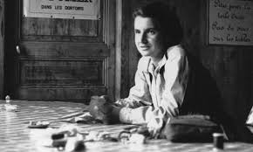
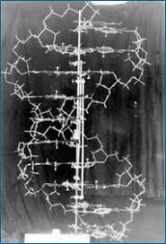
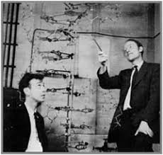
Rosalind Franklin
x-ray structure DNA
Watson and Crick
DNA model

Slide 4

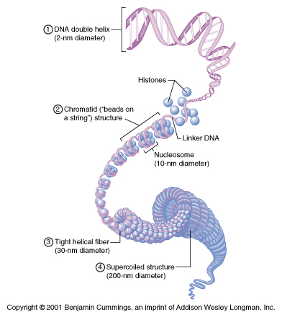
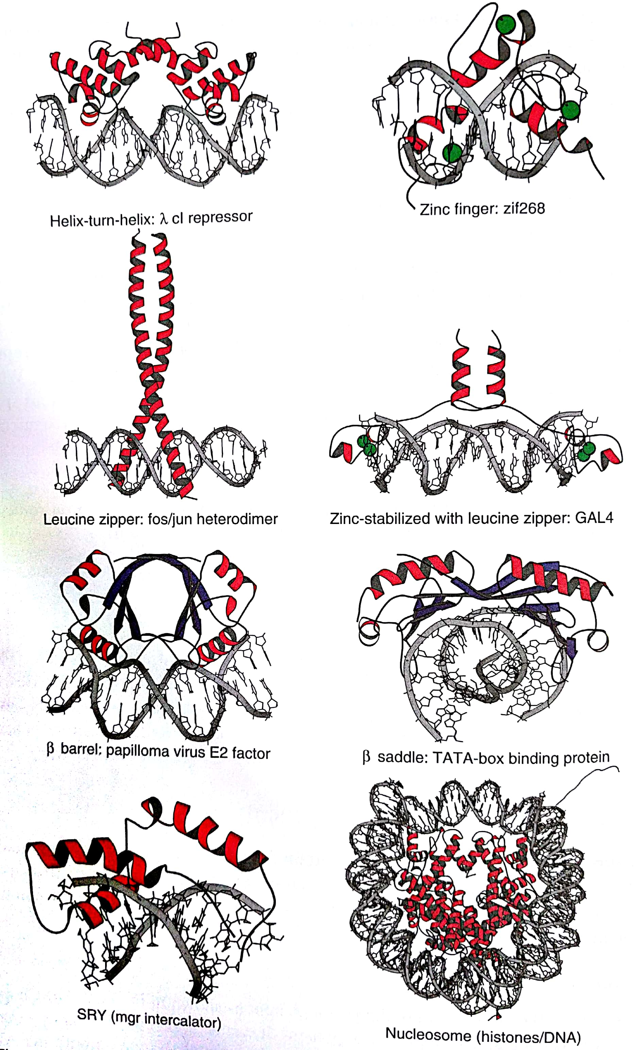
Structural levels
Primary structure (sequence: ATTACCTGCTGGGAA)
Secondary structure (helices)
Terciary structure (super-helices)
Quaternary structure (complexes)

Slide 5
Structural parts in nucleic acids

Slide 6
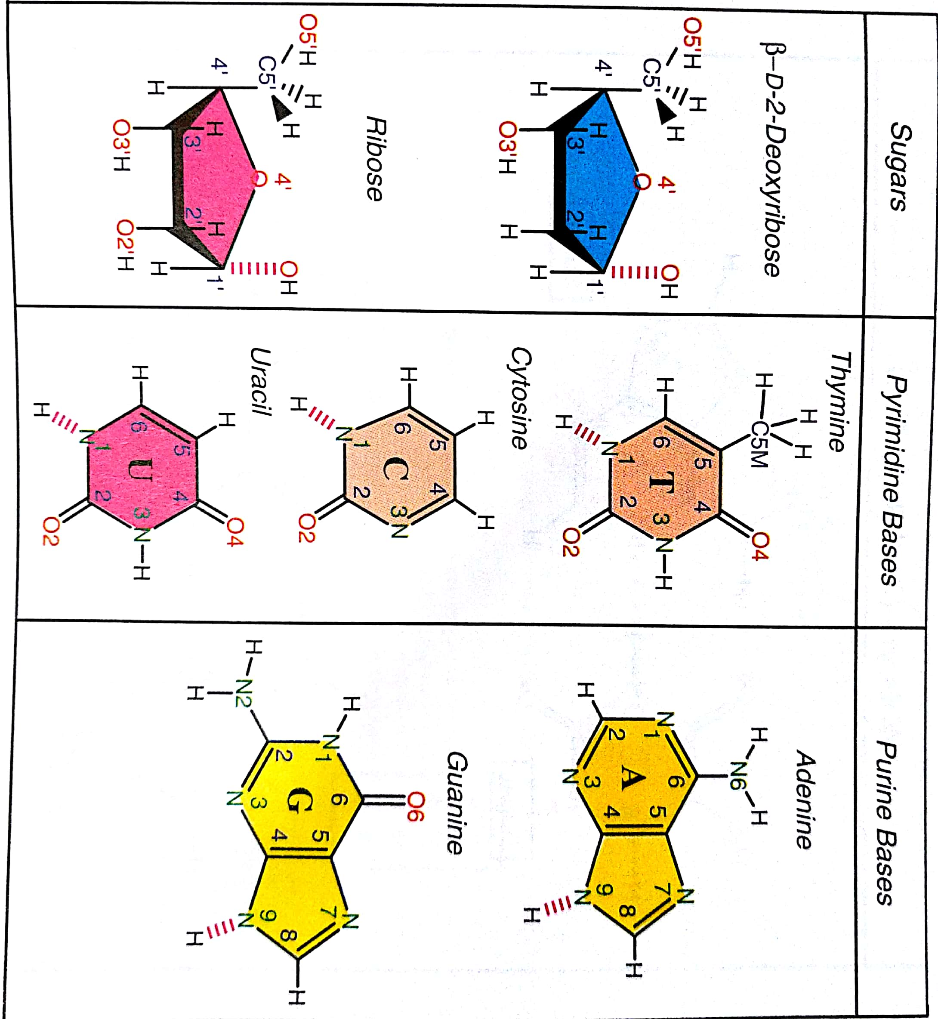
Nitrogenous bases and sugars
Molecular Modeling and Simulation. Tamar Schlick

Slide 7
Bases give a unique H-bond pattern
Bond
to sugar
δ+
δ-
DNA
RNA
Molecular Modeling and Simulation. Tamar Schlick

Slide 8
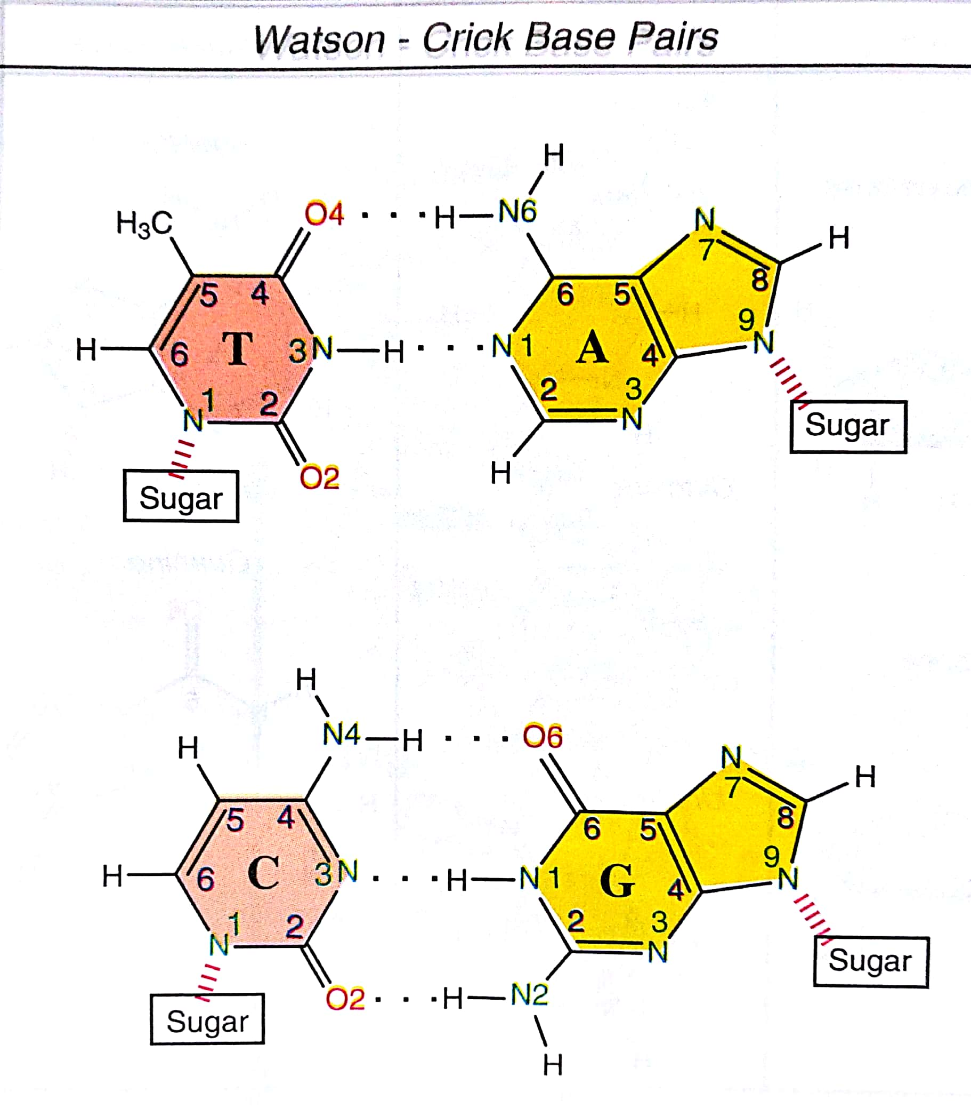
Canonical hydrogen bond pattern
Molecular Modeling and Simulation. Tamar Schlick

Slide 9
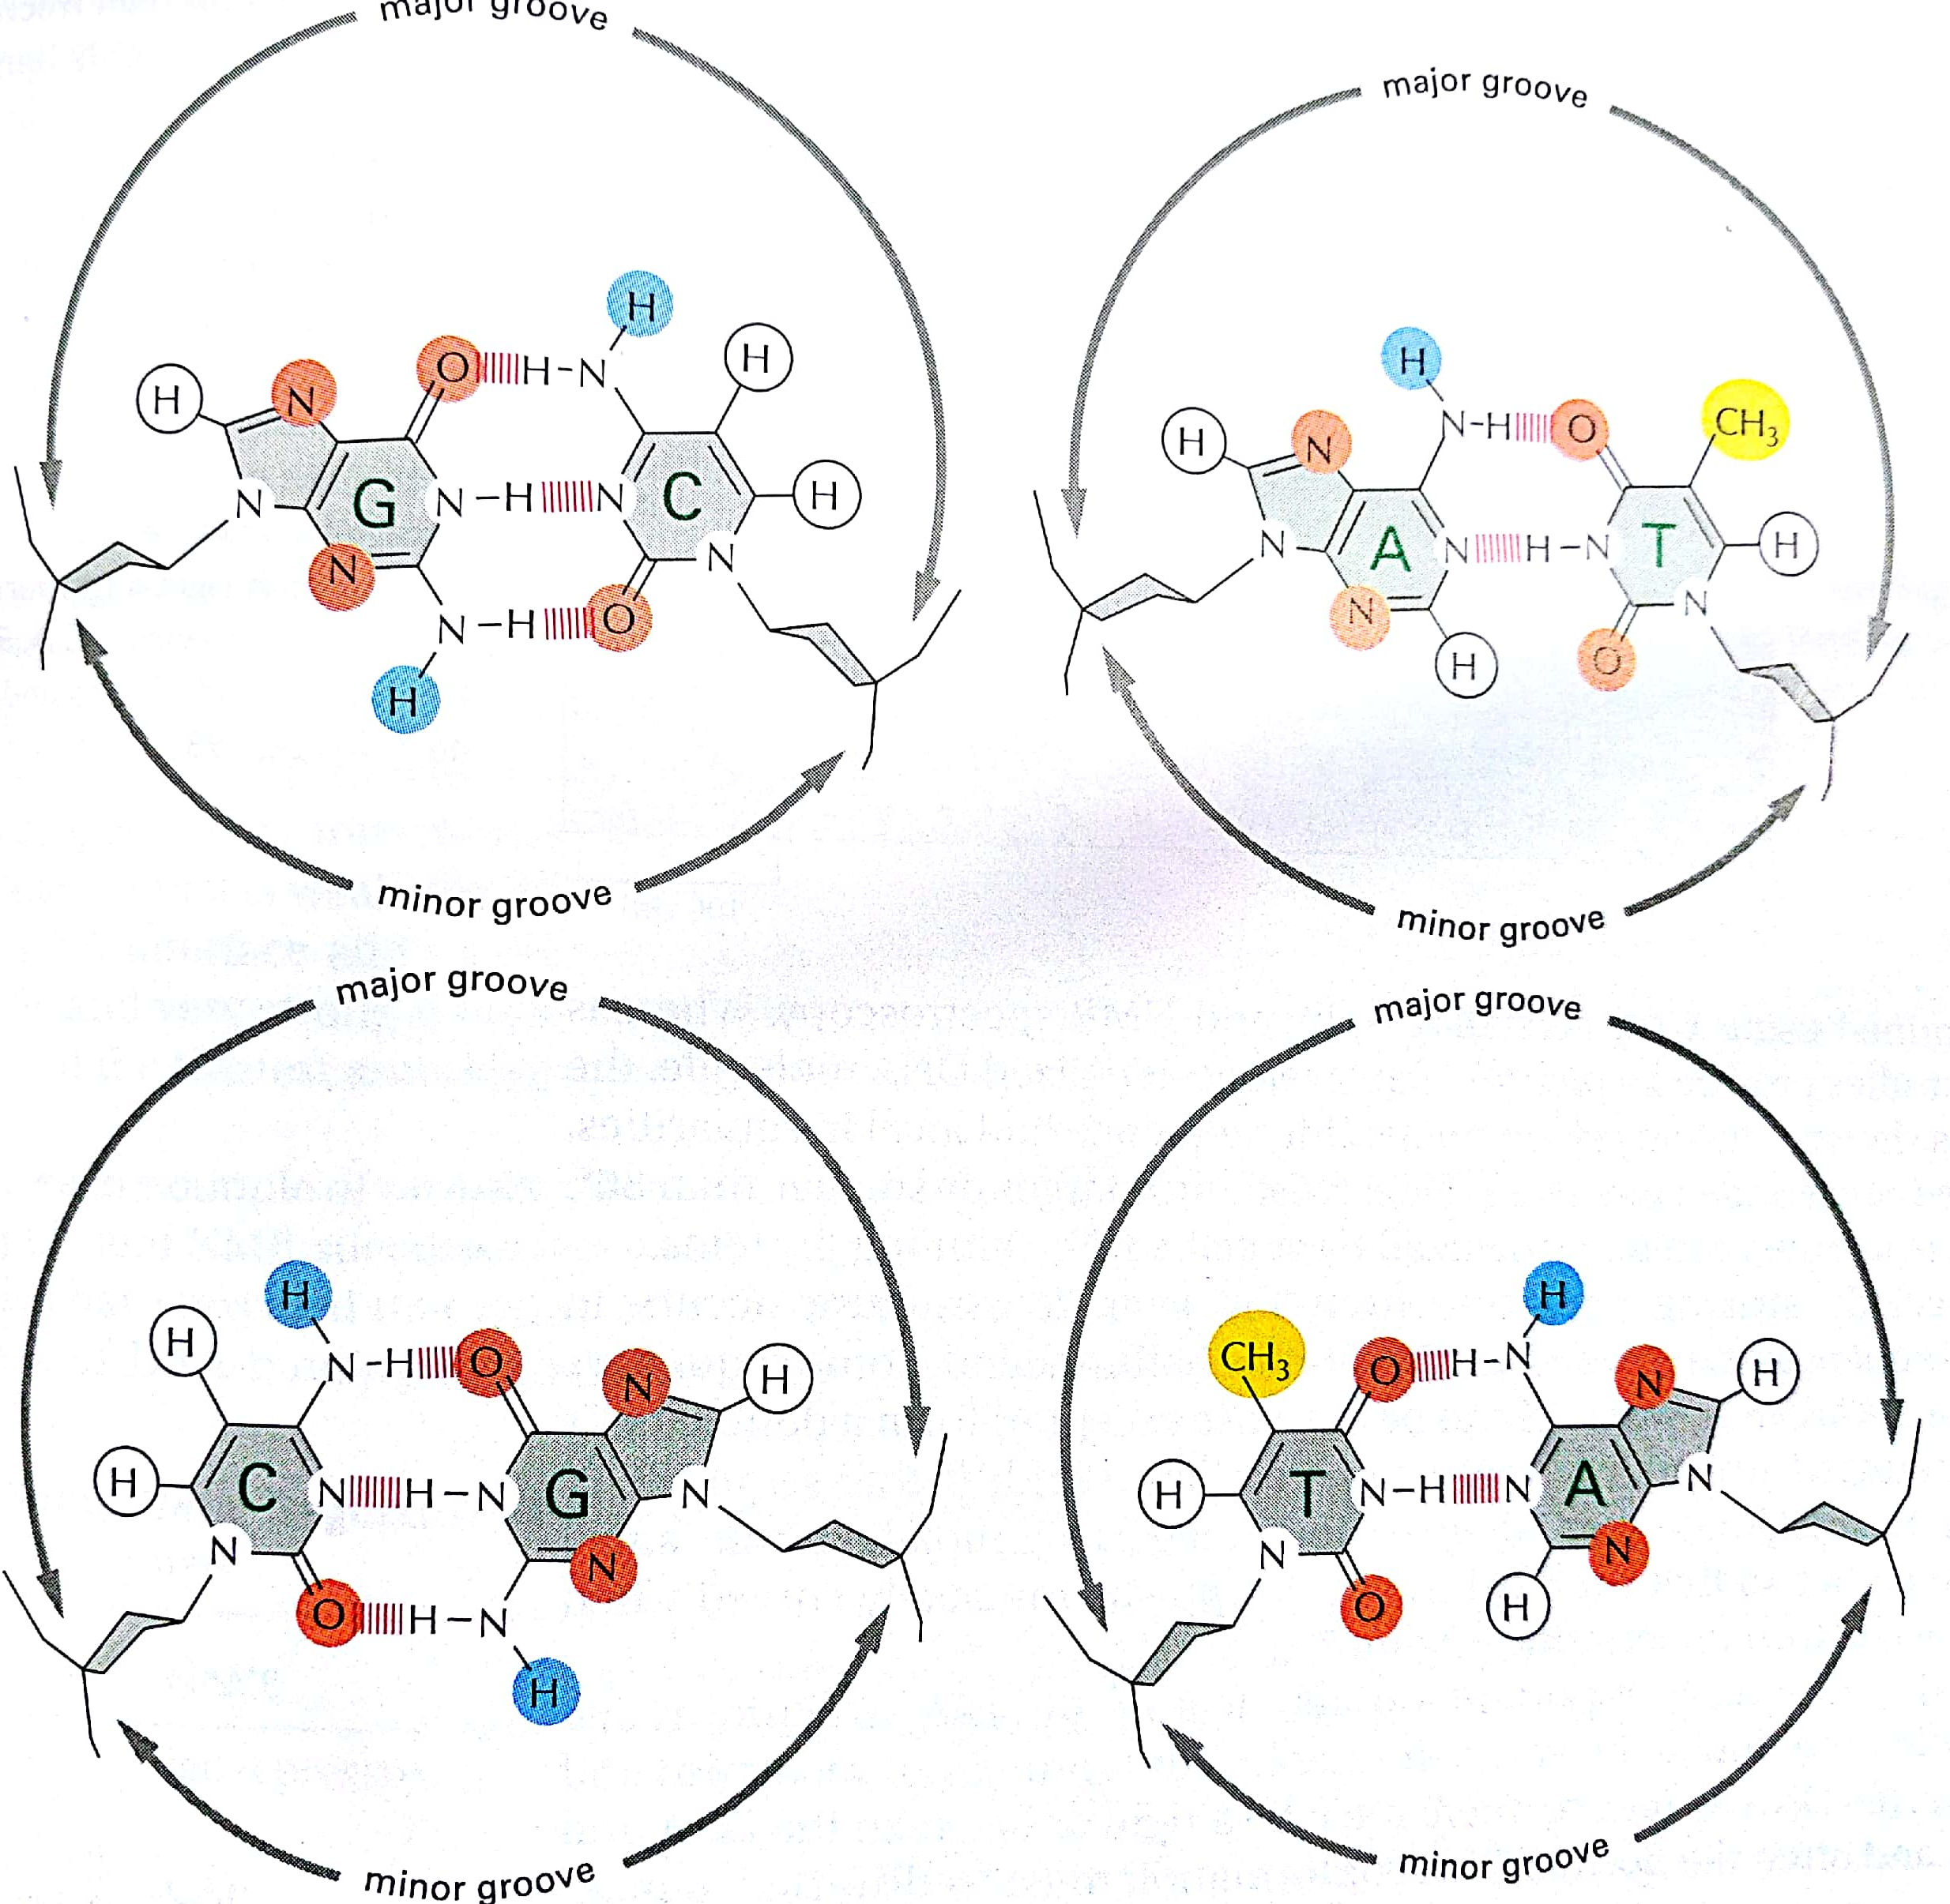
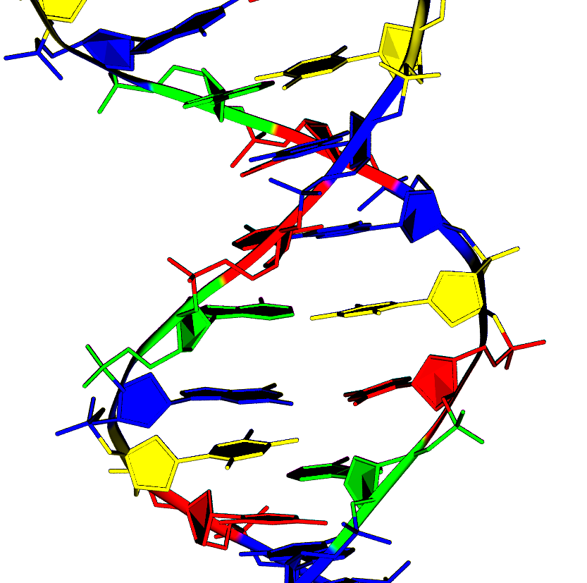
Canonical hydrogen bond pattern
minor groove
major groove
Molecular Biology: The Cell. Bruce Alberts

Slide 10
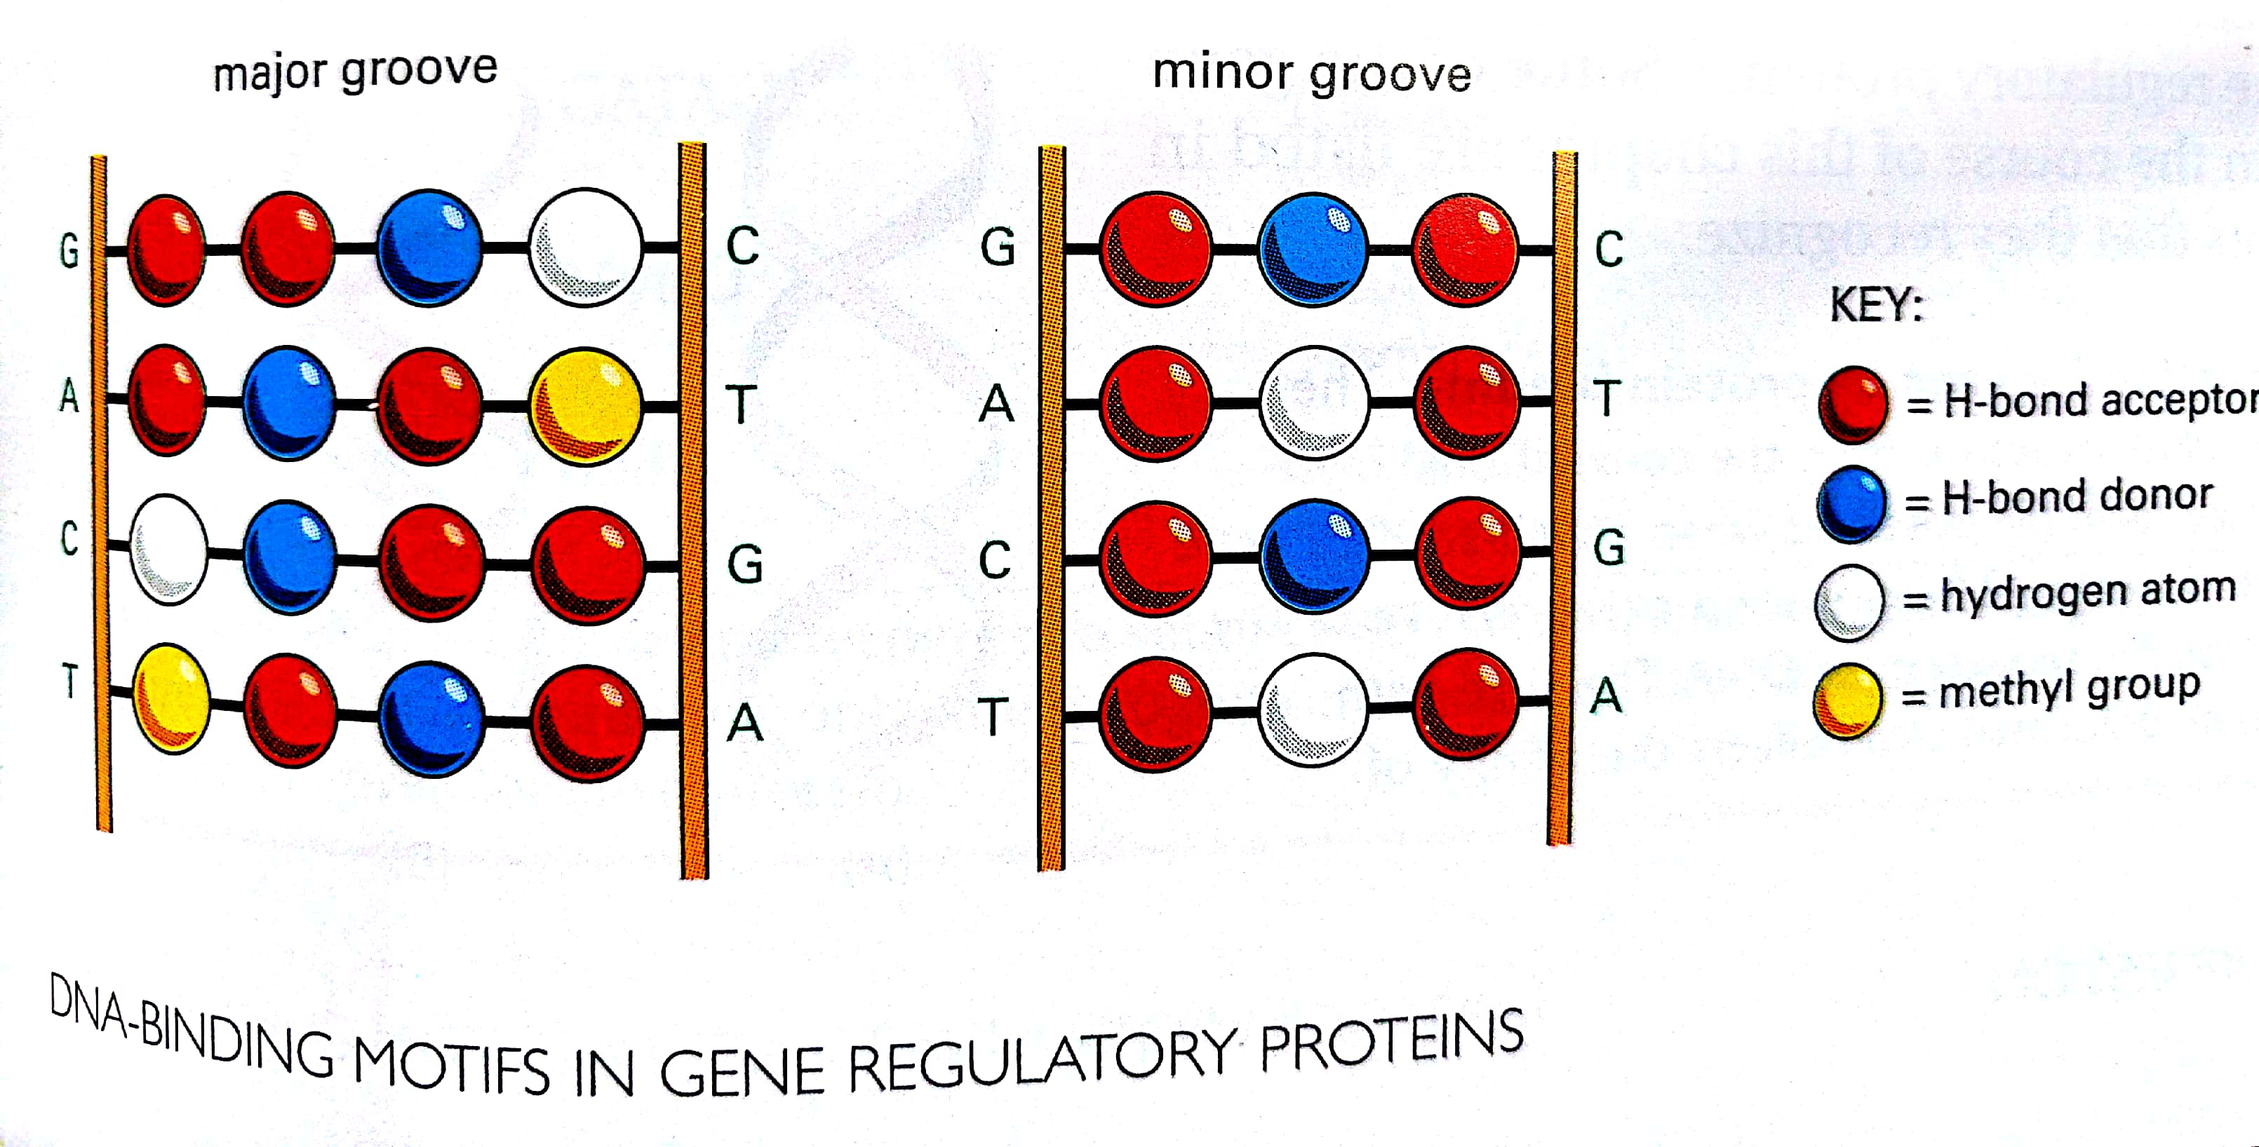
How other molecules can interact DNA
Not all hydrogen bond donors/acceptors are used
Possibility to interact with:
Drugs
Proteins
Molecular Biology: The Cell. Bruce Alberts

Slide 11
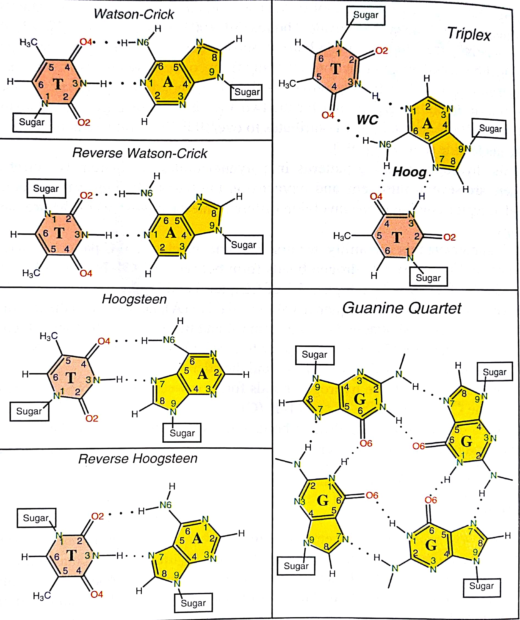
Many possible non-canonical pairings!
Molecular Modeling and Simulation. Tamar Schlick

Slide 12
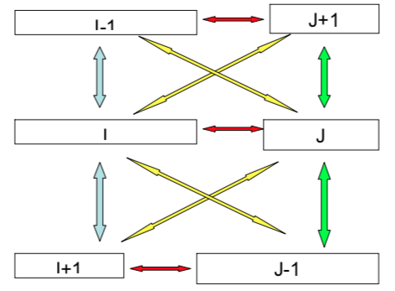
Base interactions
Stacking interactions
Hydrogen Bond interactions
Solvation
H-Bonds
Intra Stacking
Inter Stacking

Slide 13
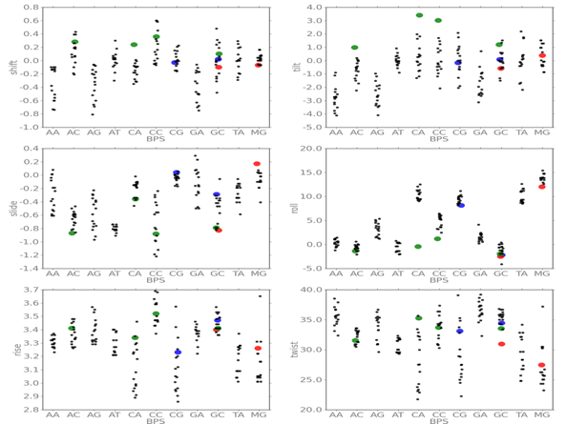
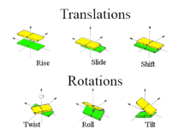
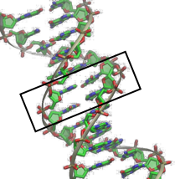
DNA exhibits DNA sequence dependent properties in terms of structure and flexibility
Structure
Measure
Sequence dependent behavior

Slide 14
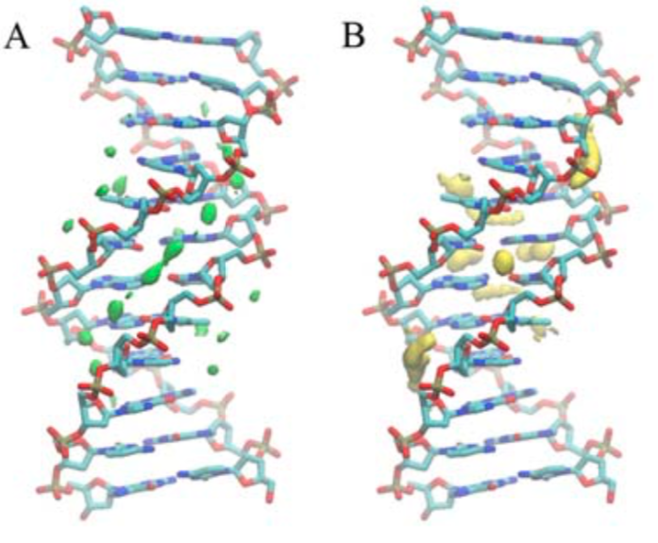
Solvation
The double chain and arrangement of phospates (minor groove width and depth allow for regions of preferred interaction with water / ions.
Seen here are solvation maps were the water density is 2.5 times higher than bulk (green) and ion densities are greater than 2 times bulk (yellow).

Slide 15
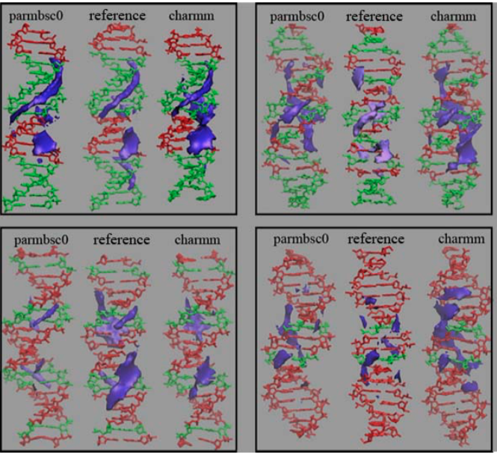
Properties are sequence dependent
C:G pairs
A:T pairs

Slide 16
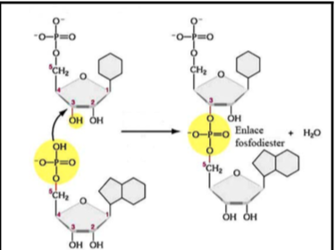
Phosphodiester bonds form the NA backbone

Slide 17
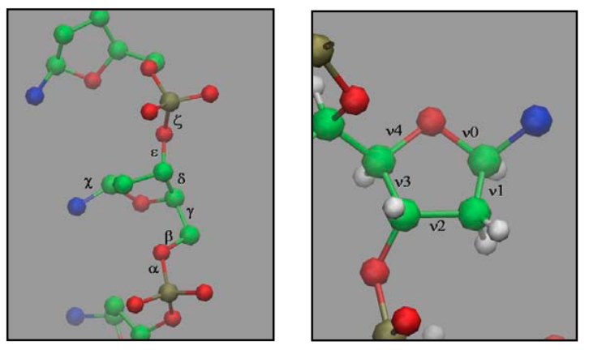
The sugar
Highly flexible. Links between the phosphates. RNA has a ribose. DNA has a 2-deoxyRibose. Ribose has more limited conformational preferences than 2-deoxyRibose in this environment.
If bases give the recognition properties for NA (direct readout), the sugars and phosphodiesters give the conformational flexibility (indirect readout)

Slide 18
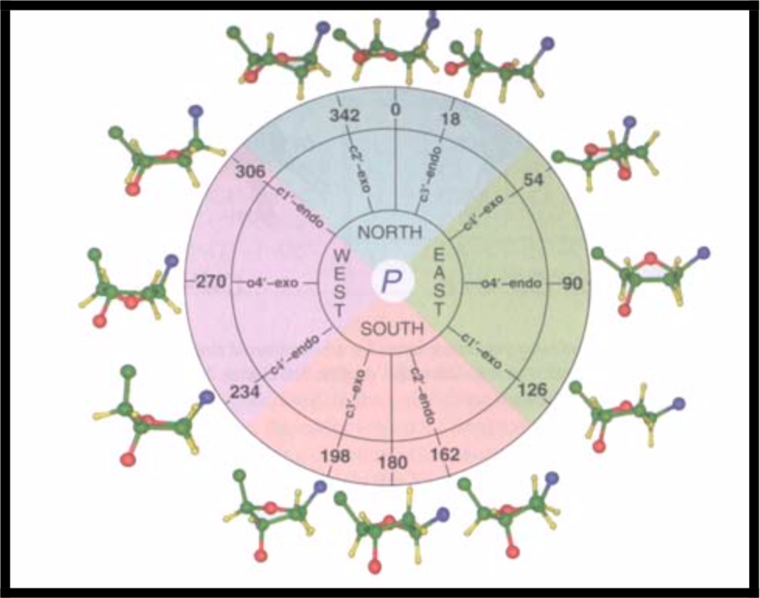
Sugar puckering
North (C3’ endo) and South (C2’endo) are the most common
W is never accessible
RNA, A-DNA —> N puckering
B-DNA: mostly S, some E.

Slide 19
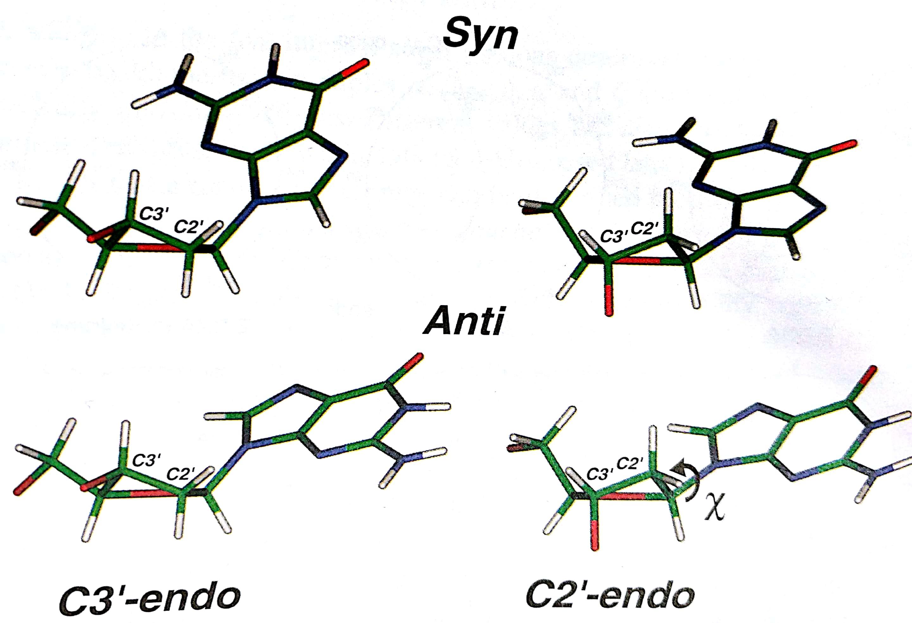
Base with respect to sugar can be either syn or anti
Anti is the most common. Guanine is the only nucleoside that sometimes goes to Syn

Slide 20
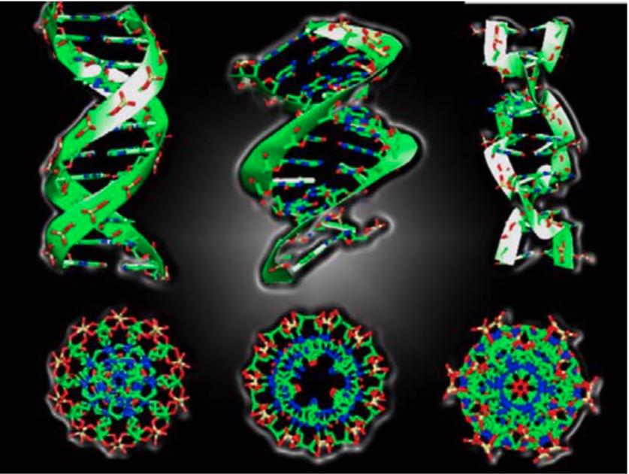
Solvation preferences, puckering, backbone determine DNA structure
B-DNA
A-DNA
Z-DNA

Slide 21
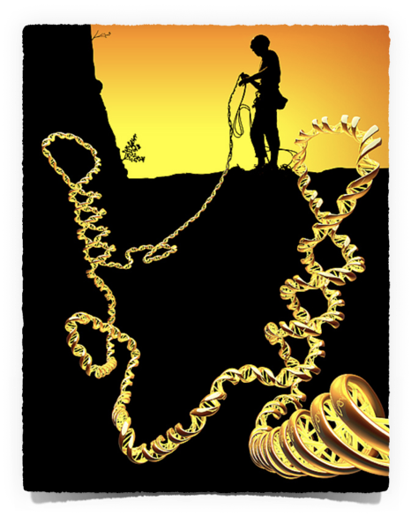
Higher order DNA sequence
We have 2 meters of DNA (6 feet) in every cell in our bodies. They have to fit in a nucleus that is 5µm in length.
Need to pack DNA
~2% of the DNA codes for proteins. Other regions are regulatory, repressors, enhancers,… involved in gene regulation.
Need to keep DNA accessible

Slide 22
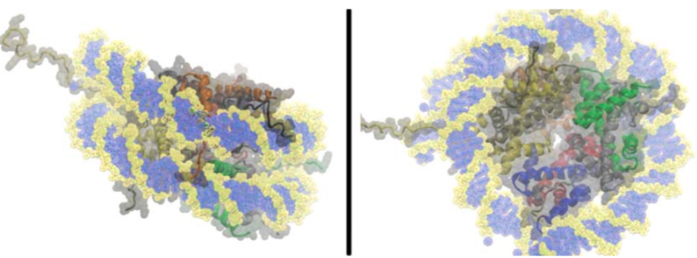
The nucleosome is the core particle for packing
147 bases of DNA wrap themselves 1.75 times around the histone octamer (H2A, H2B, H3 and H4).
Resulting structure is 220Å (10x compression).
Linker DNA (~100 base pairs) is used to connect nucleosomes

Slide 23
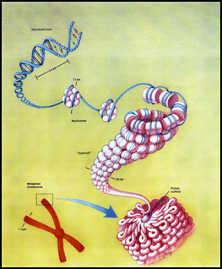
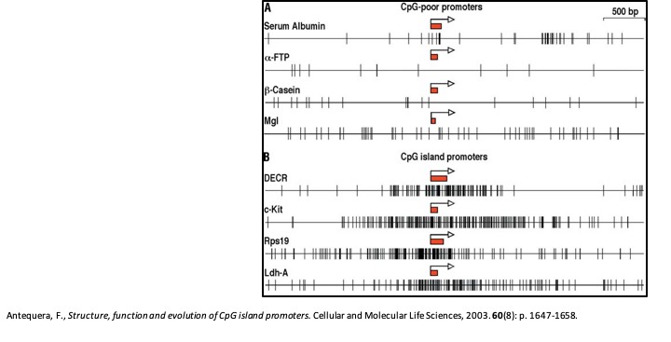
The nucleosome is the core particle for packing
Packing affects which information can be used

Slide 24
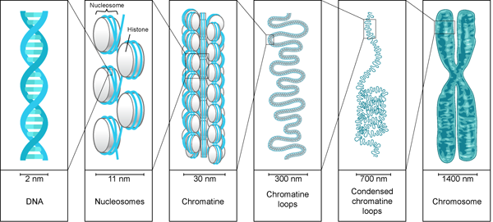
There is no clear picture of the steps going from nucleosome to chromosome—HiC experiments could change that

Slide 25
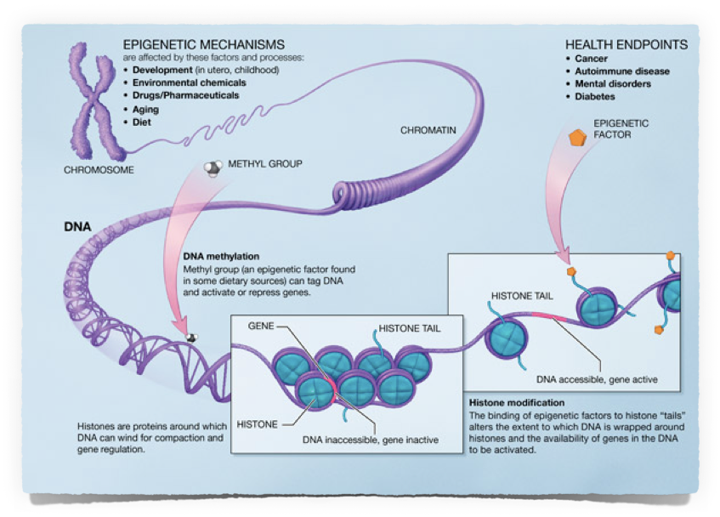
Epigenetic changes affect packing preferences (cells in different tissues express different proteins)

Slide 26
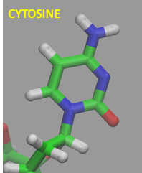
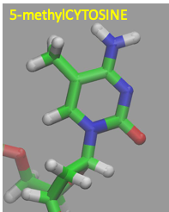

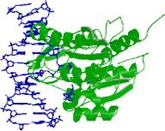
DNA methylation happens in mammals at 5’-CpG-3’
Cytosine
5-methylCytosine
Epigenetic change
Methyltransferases

Slide 27
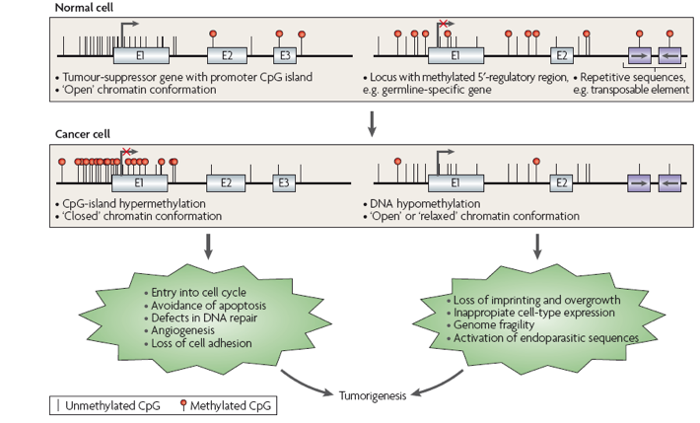
Abnormal methylation patterns lead to cancer

Slide 28
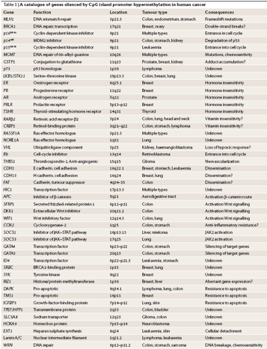
A few known cancers due to hypermethylation

Slide 29
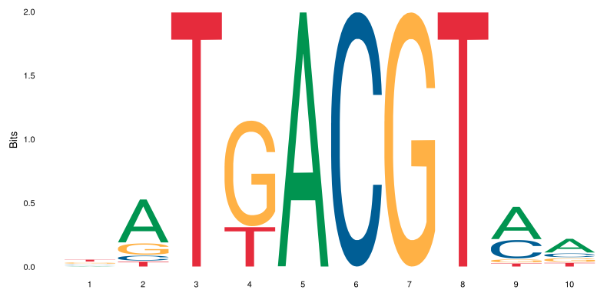
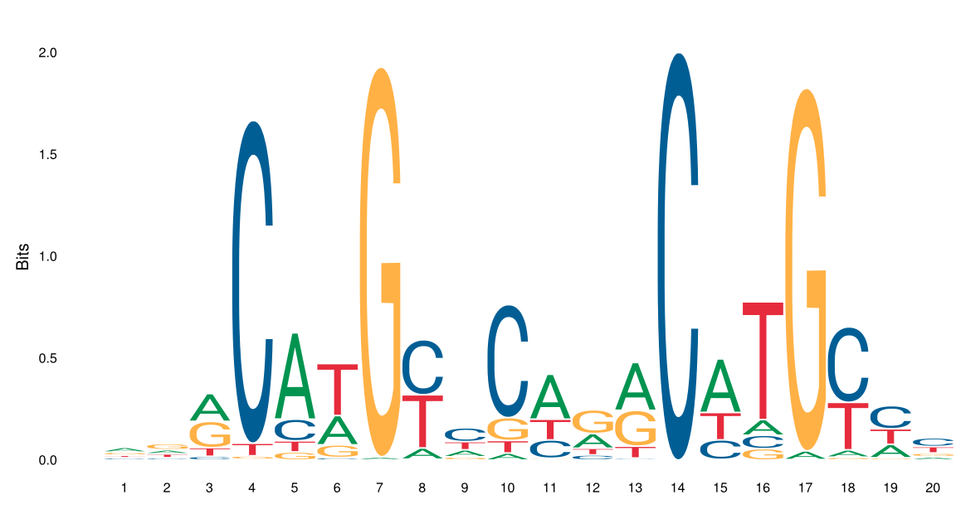
Gene regulation: protein-DNA interactions
Transcription factors (proteins) bind specific sequences of DNA.
They bind a few bases of DNA (6 to 10).
There are 4**10 possible sequences of DNA 10mers
Need to differentiate affinity and selectivity:
Affinity: strength of the interaction protein-DNA
Selectivity: how well the protein differentiates between different DNA sequences
Some TF are very selective — some are very promiscuous
Rules for understanding TF binding are an area of hot research
Selective
Non-Selective

Slide 30
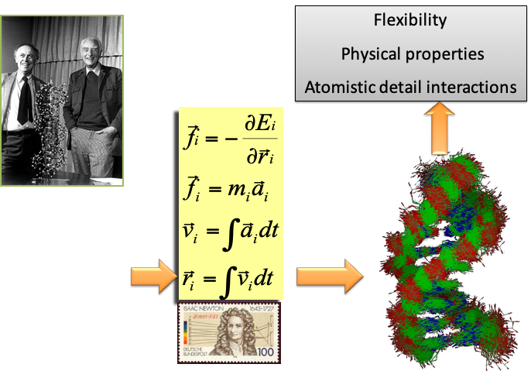

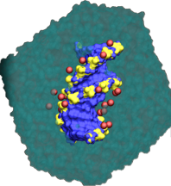
Atomistic models of DNA

Slide 31
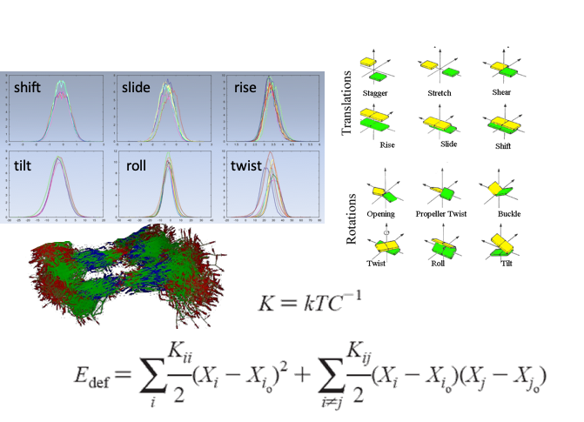
DNA is flexible
Structure and flexibility dictate DNA’s ability to interact with proteins, form nucleosomes, …

